Slide 1
CSE 2500: Introduction to Discrete Systems
Lecture 15:
Mathematical Induction
Kaleel Mahmood
Department of Computer Science and Engineering
University of Connecticut

Slide 2
1. Sequences (review from last lecture)

Slide 3
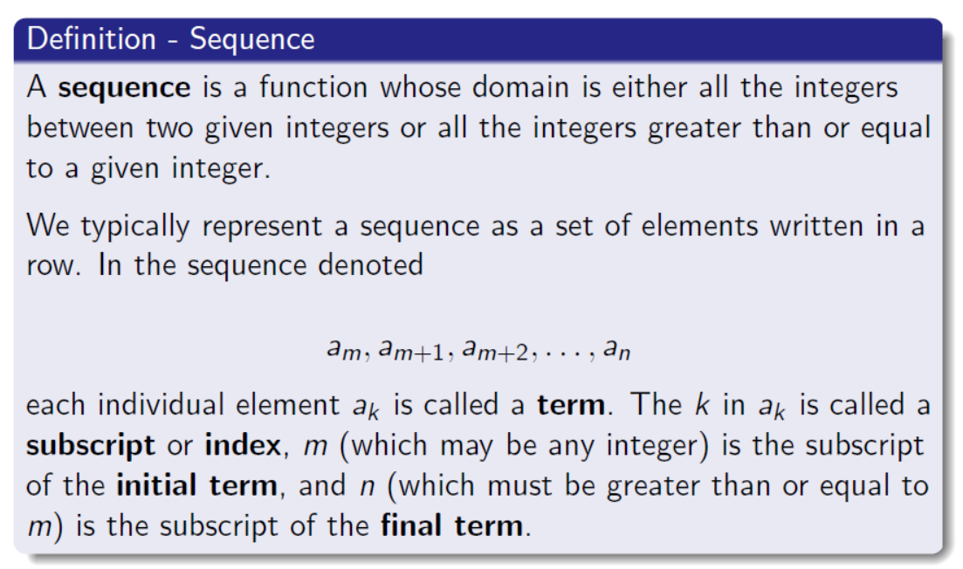
Review from last lecture:

Slide 4
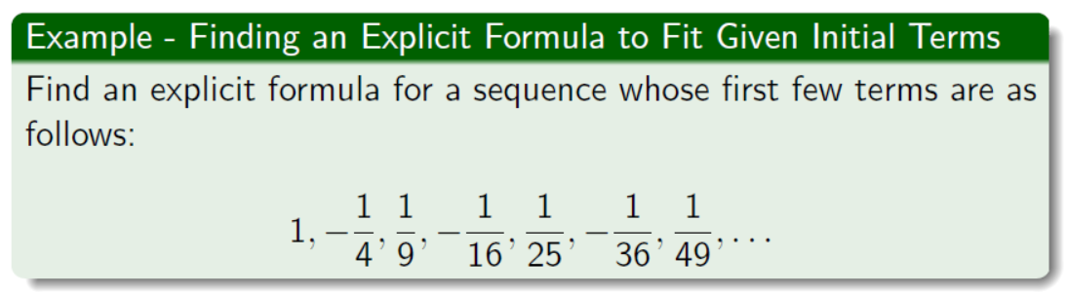
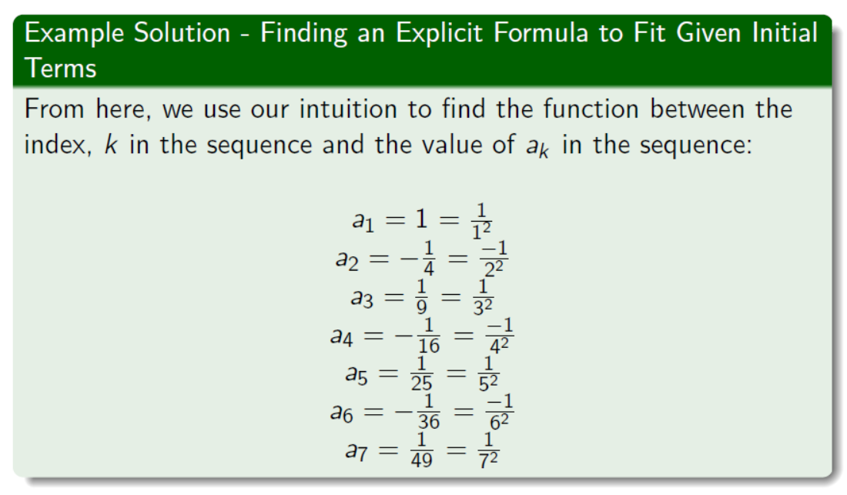

Slide 5
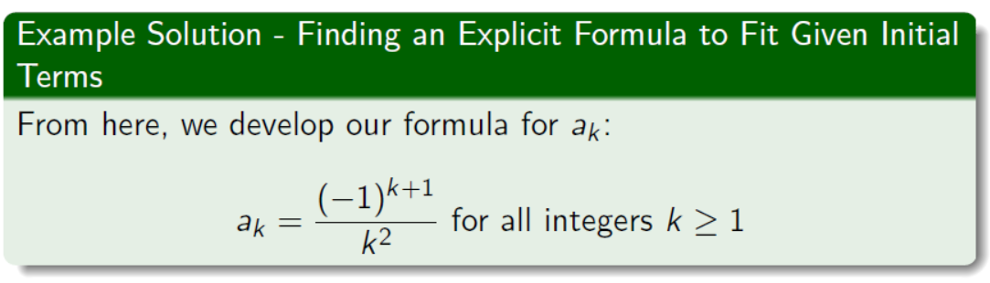

Slide 6

2. Mathematical Induction
Basic idea, show that something works for the case $n$ then show that it will work for the case $n+1$.

Slide 7
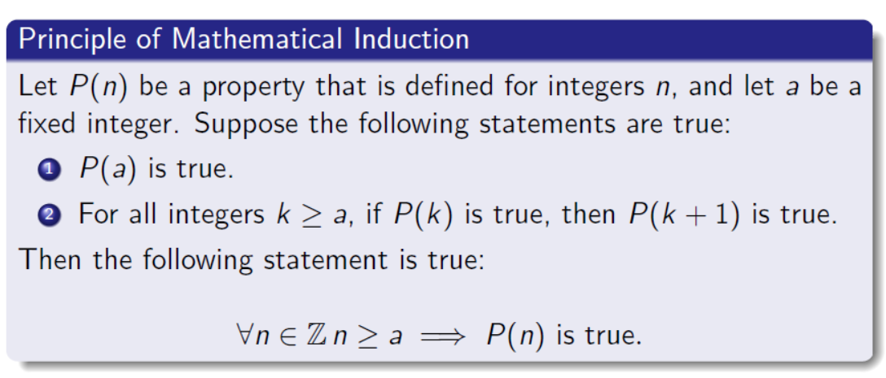

Slide 8
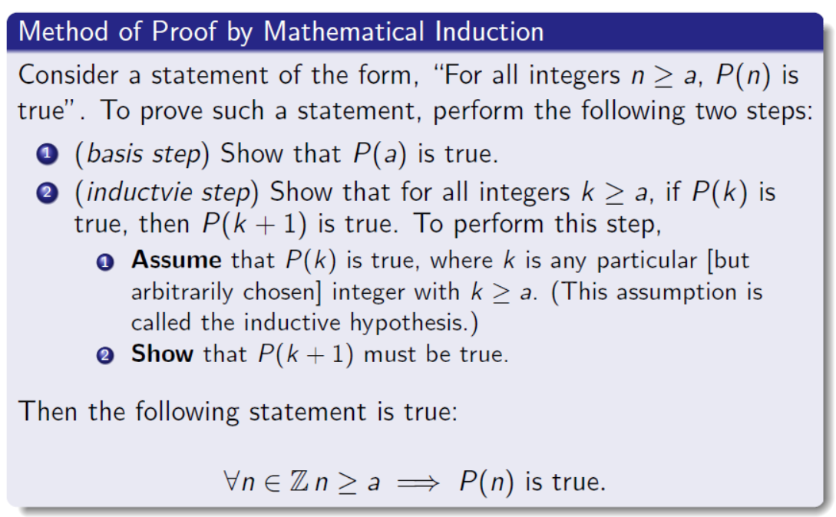

Slide 9
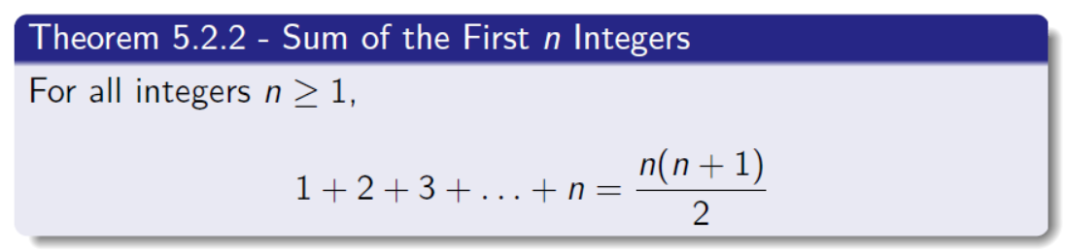
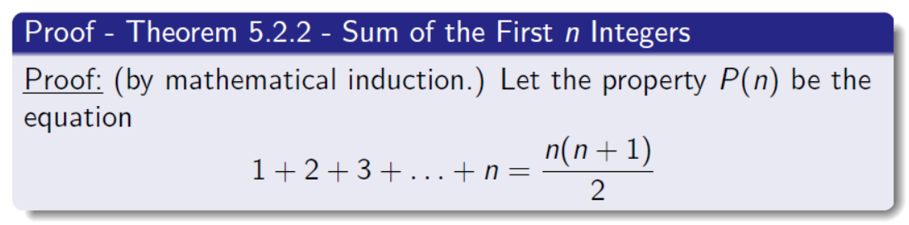

Slide 10
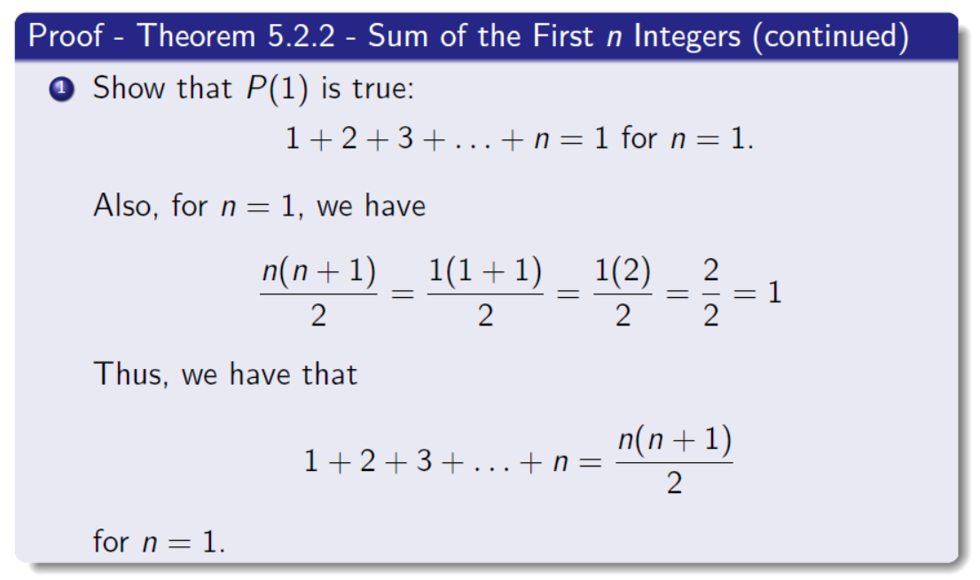

Slide 11
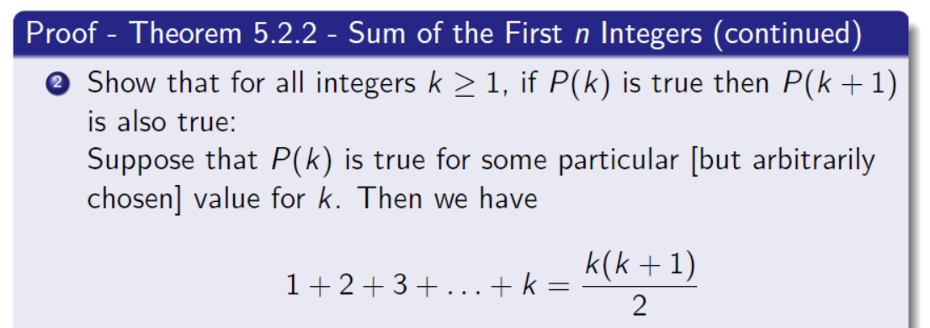
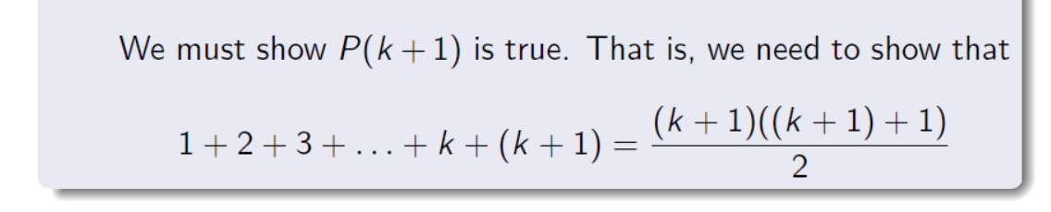

Slide 12
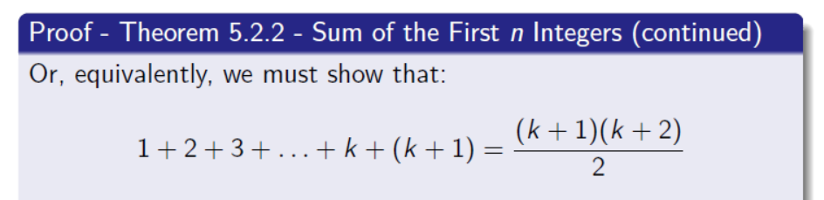
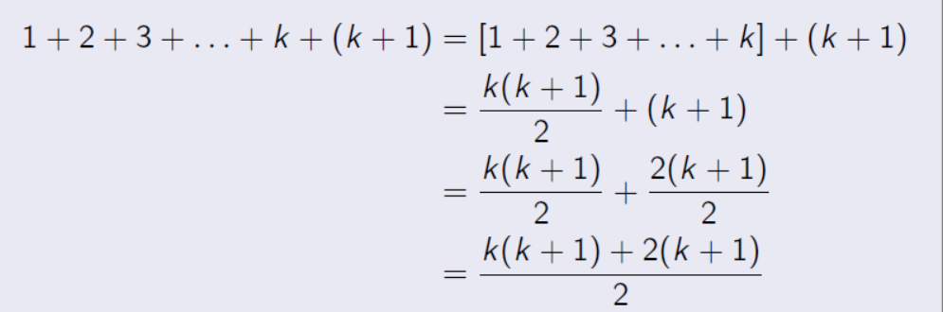

First just look at the left hand side of the equation:
$$=\frac{k^{2}+3k+2}{2}$$

Slide 13
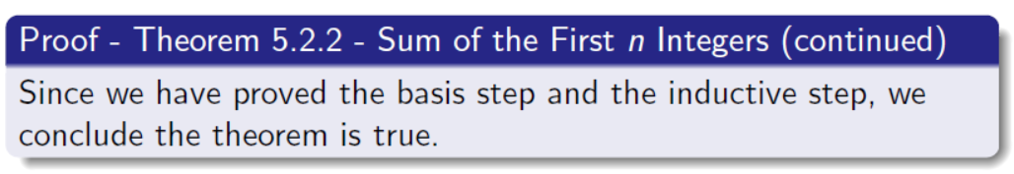

Now look at the right hand side of the equation:
$$=\frac{(k+1)(k+2)}{2}$$
$$=\frac{k^{2}+3k+2}{2}$$

Slide 14
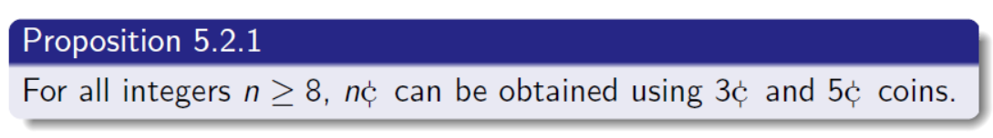
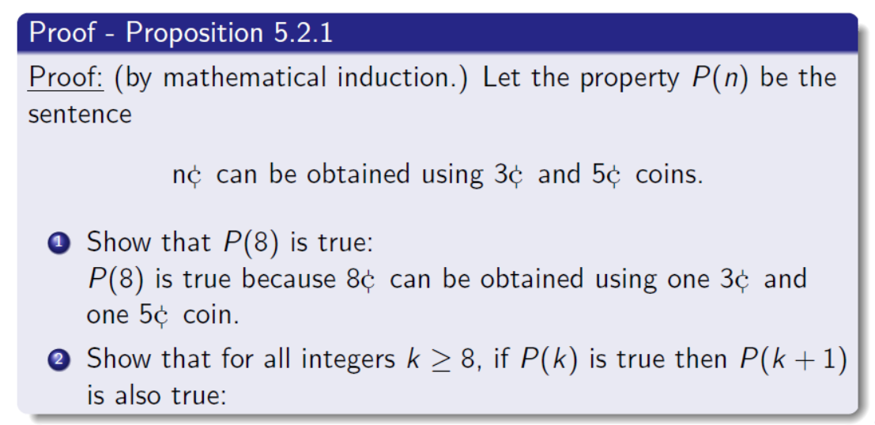

Slide 15
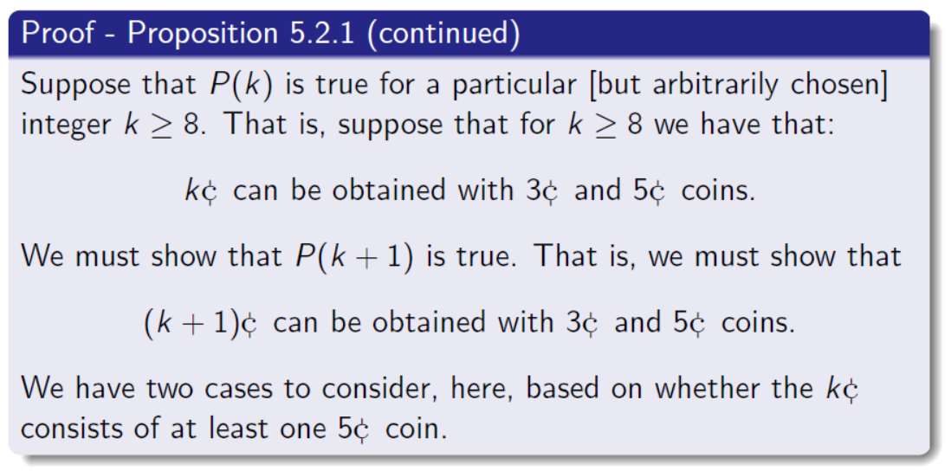

Slide 16
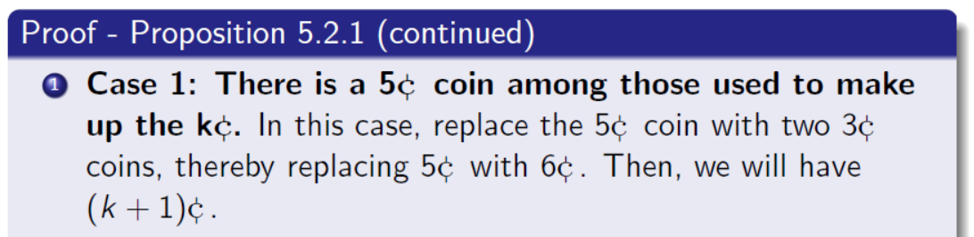
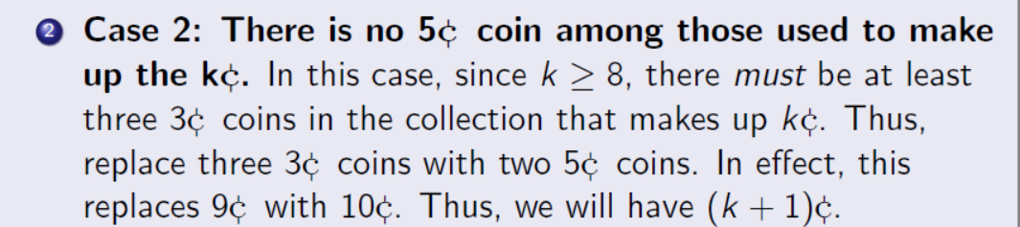
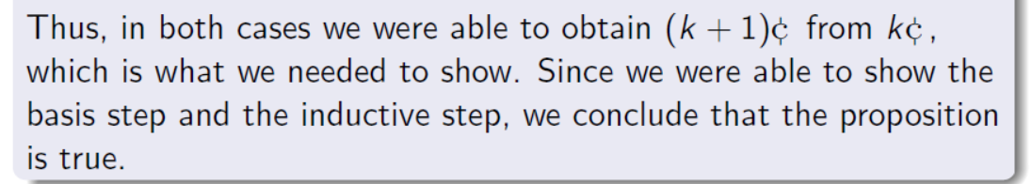

Slide 17
Another Mathematical Induction Example

Slide 18
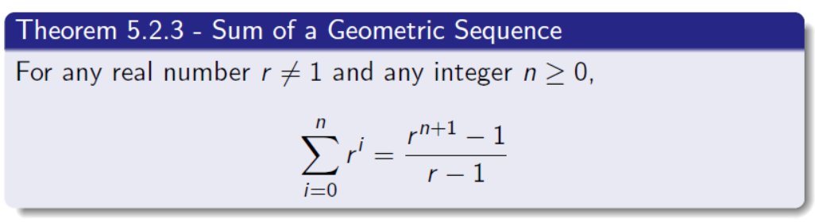
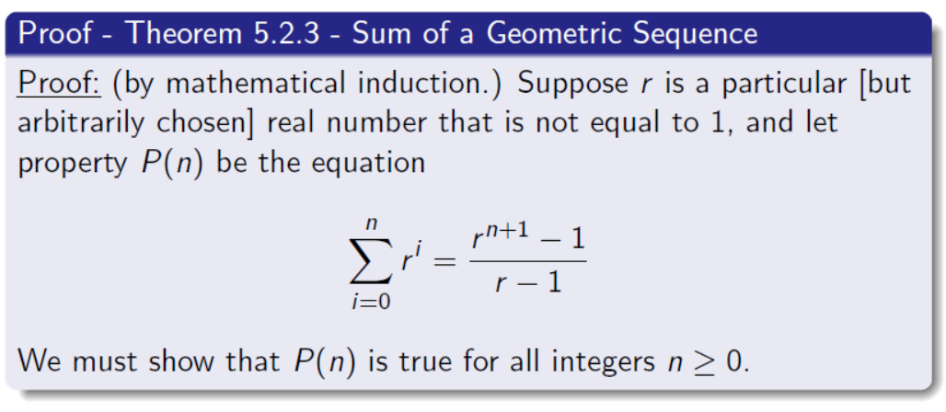

Slide 19
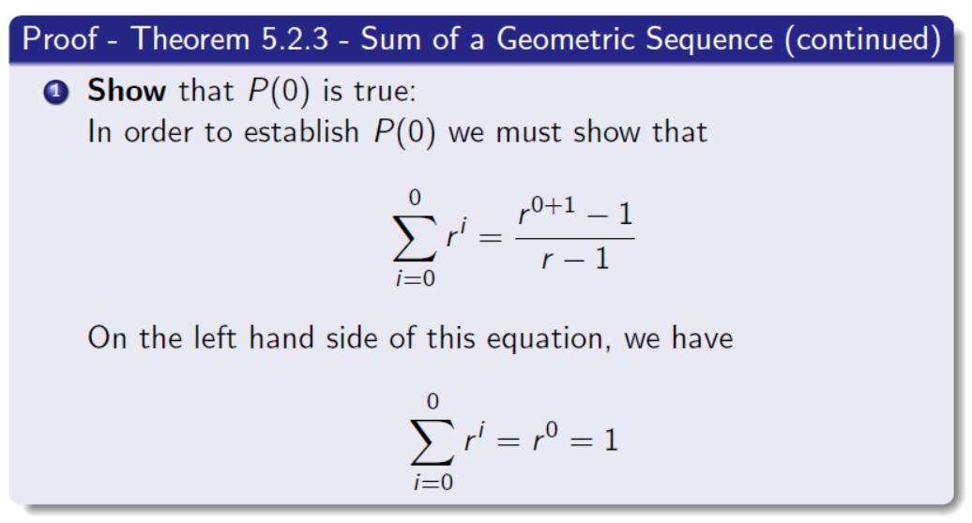
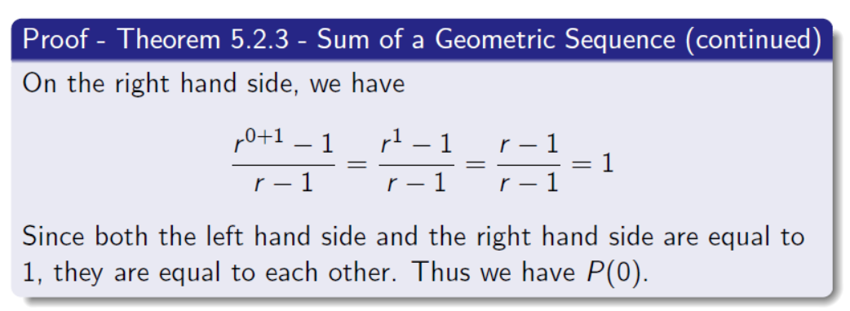

Slide 20
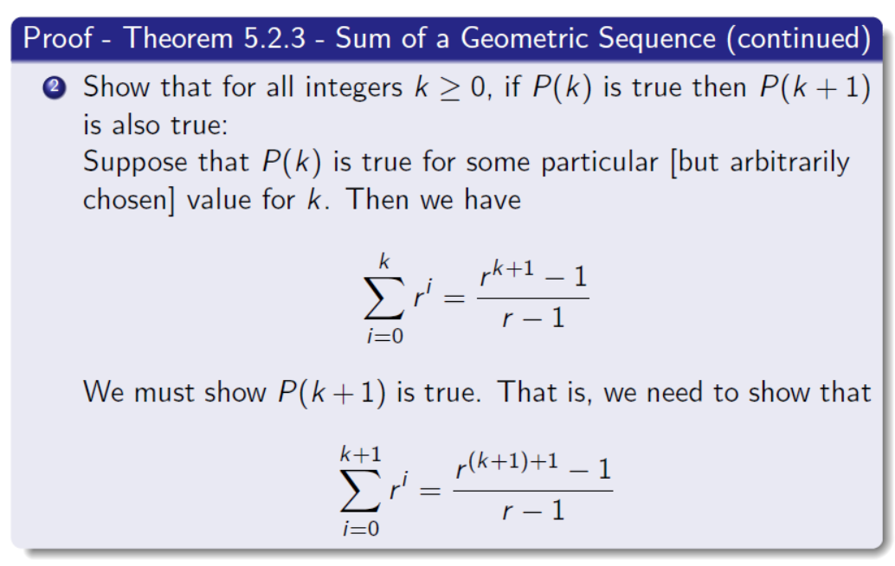

Slide 21
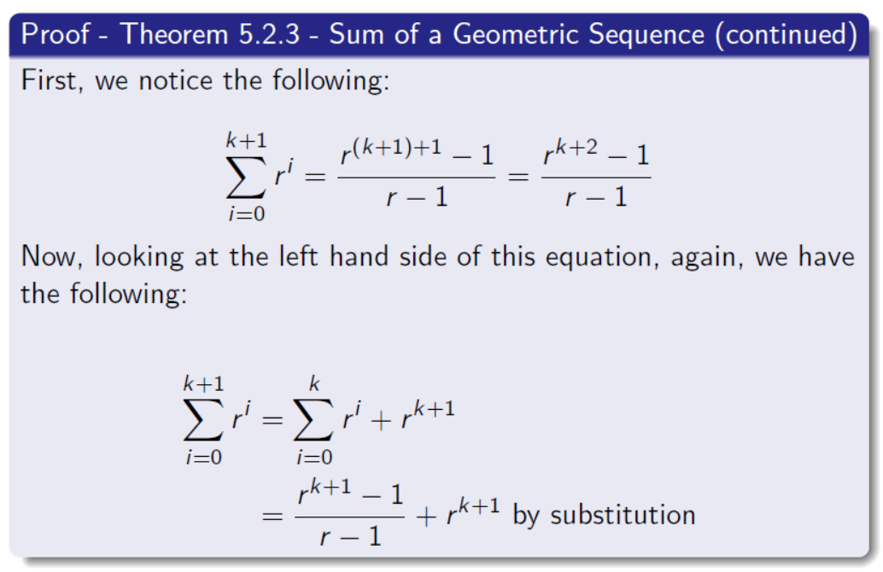

Slide 22
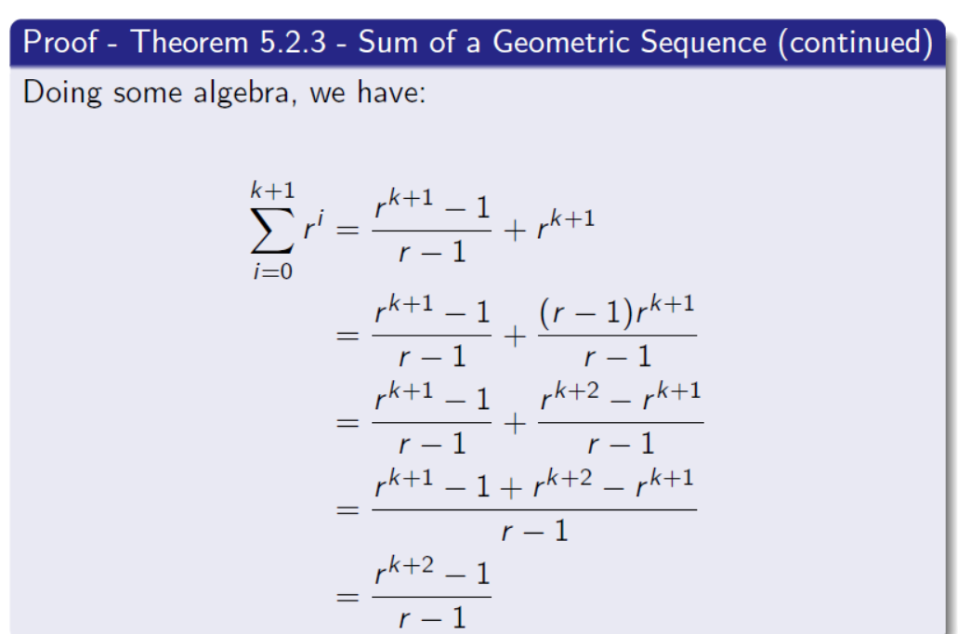

Slide 23
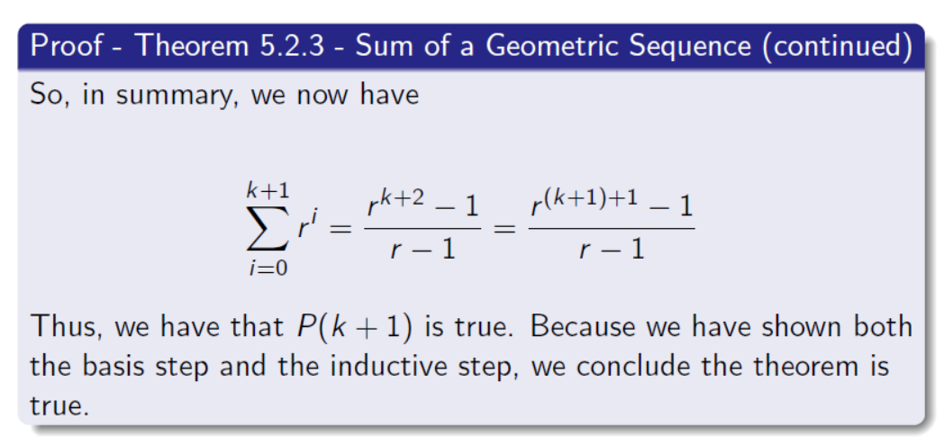

Slide 24
Give Back Exams

Slide 25
Figure Sources
Professor Joe Johnson’s Lecture Slides
https://www.google.com/url?sa=i&url=https%3A%2F%2Fwww.istockphoto.com%2Fphotos%2Fdominoes-falling&psig=AOvVaw3rtpMJk3kqH-zHaMqhZwZF&ust=1646718450484000&source=images&cd=vfe&ved=0CAsQjRxqFwoTCPCB47Oms_YCFQAAAAAdAAAAABAK

